Slide 1
ECI - Early Contractor Involvement
Why assembling the
right build team early
creates winning outcomes
Notes:
Hi, I’m Jeremy Hawkes MD of our 2nd generation family business, thank you Kristian for passionately painting a picture of the Boweng way, what we’re about and where we want to go. Also a big thank you to everyone for coming to our event, you’re all very busy, it’s a fair distance to travel and we very much appreciate that you’ve made the effort to come along.
A few years ago, we would bid on a project, interpret the details and respond to the inquiry without too many questions, this is how things were then. Our approach pretty much stayed this way because that’s what our customers expected, that is, until a certain project came along that we simply couldn’t bid. We couldn’t bid this project until the construction methodology was determined. I still remember the day that we were invited in “behind the curtain” to work with the designer and head contractor to come up with an approach that would work. Doing this early and as an “ego aside” collective worked, we were trusted to help feed our ideas and experience into the methodology which heavily influenced the design concept. This experience was fun, fruitful and ended up delivering a very successful outcome for everyone.

Slide 2
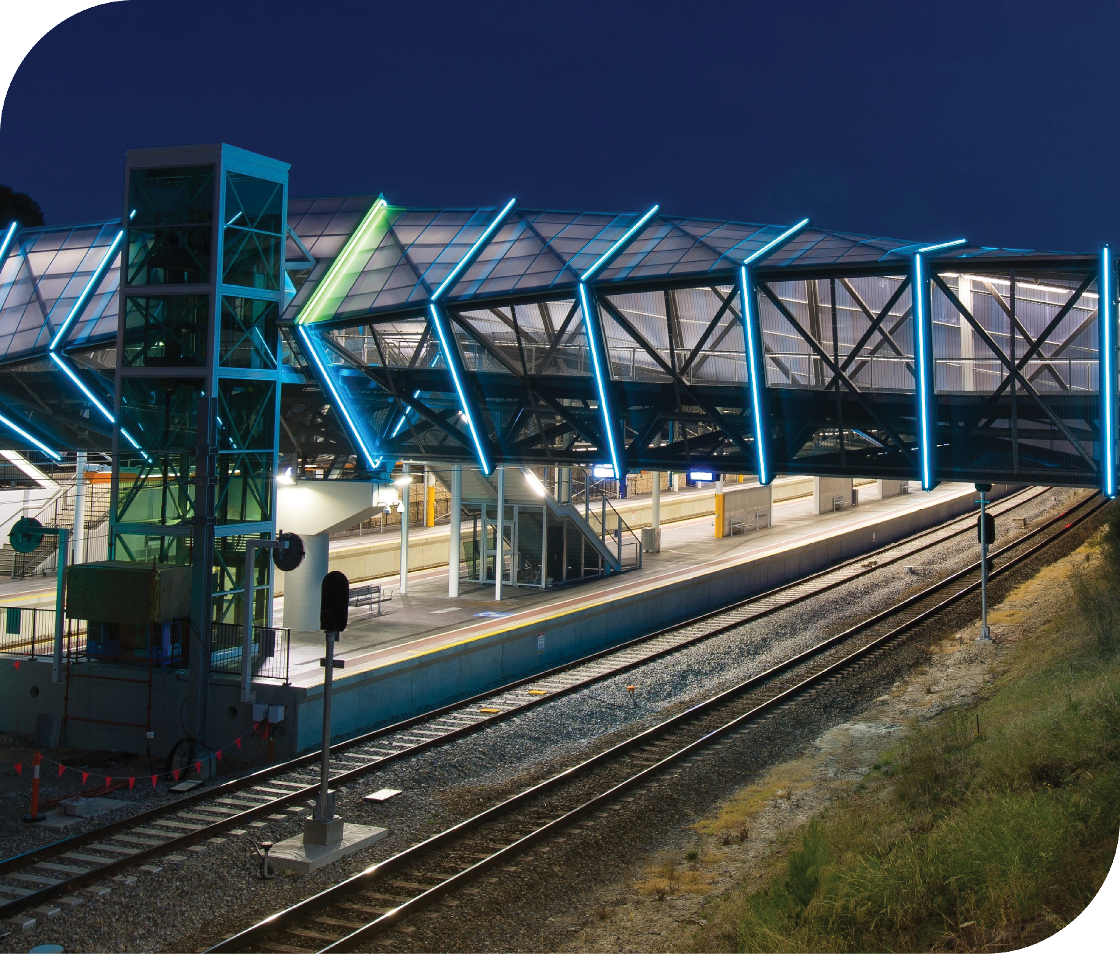
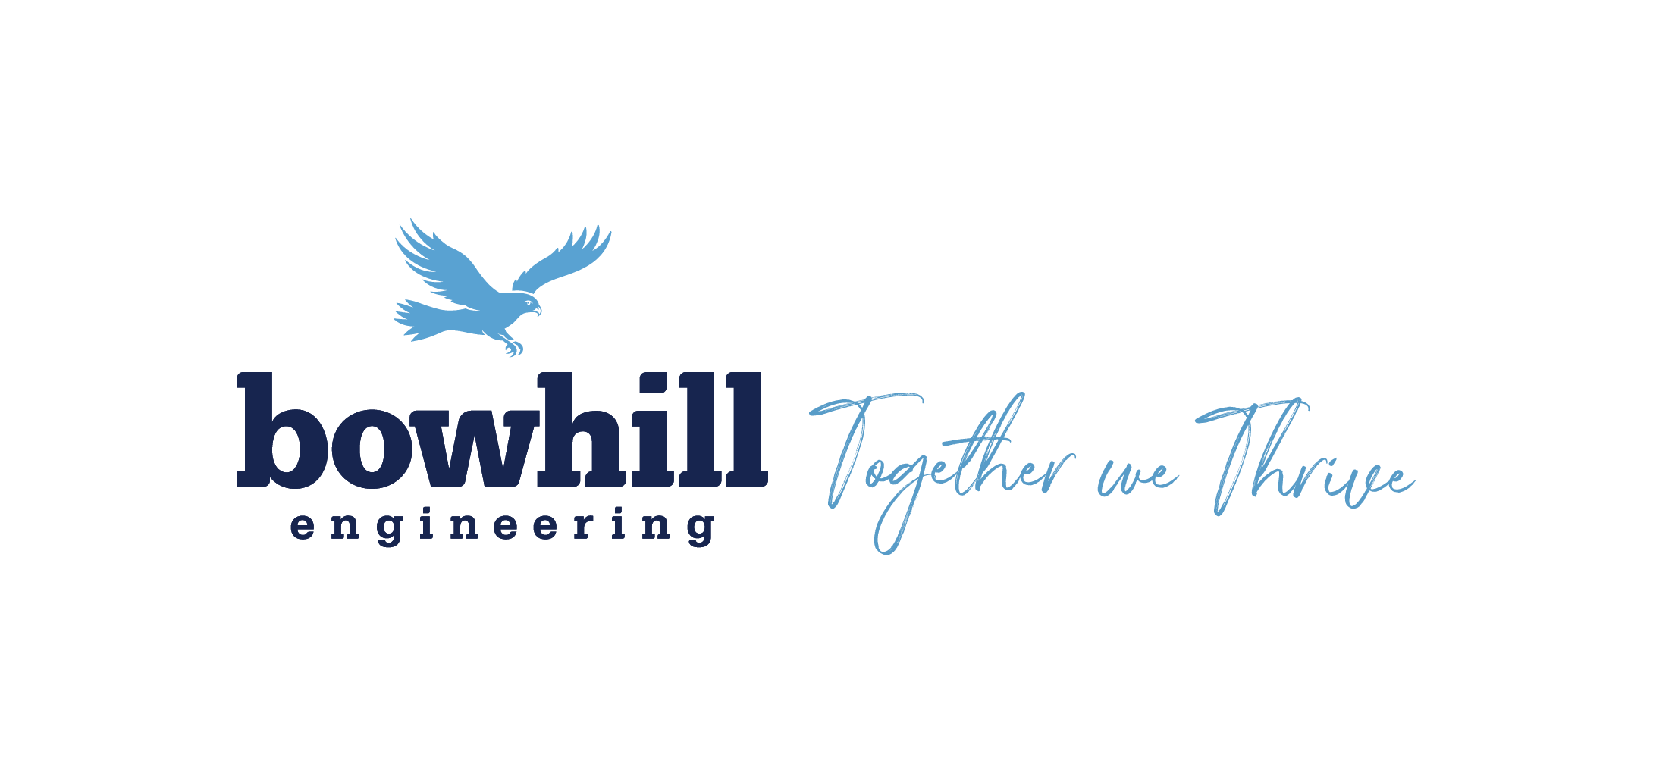
You’ve probably heard of the concept; you may even be actively working on implementation and would like some practical real-life examples to draw from.
Our experience tells us that there are fantastic, mutually rewarding and industry building solutions waiting to be discovered, it just requires the right approach to unlock them.
Notes:
That project was the Wayville Train Station, it could have gone spectacularly wrong, but it didn’t, it was on time and the installation over the live rail lines went absolutely perfectly. A massive achievement for a job with such complicated structural geometry.
Once you’d experienced this kind of high, you tend to go looking for more, ever since then we’ve had a passion for this kind of collaborative, practical approach and the many benefits that the process unlocks.
That’s why today I’d like to discuss the way Boweng have embraced ECI, early contractor involvement and the benefits that we’ve seen it unlock when embraced with meaning.
· I’m sure we have all seen the construction/manufacturing game be played, sometimes well, other times, not so well.
· It seems like the bigger the project, the more dysfunctional the relationships can get, why is this?
· Is there a way where all parties can get what they need, without hurting others in the team?
· I think it’s a fairly common observation that when the stakes are high, winning players align behind a greater purpose, they care more about the bigger picture than just themselves.
· Approaching the numerous problems that will inevitably appear, it doesn’t necessarily have to be someone’s fault, in fact, what if 90% of these issues could be avoided, before they even appear!
· This is an approach that Bowhill Engineering are dedicated to master.

Slide 3
“Our findings indicate that designers and contractors capable of carrying out this balance successfully for their clients will have a major competitive advantage.”
- EXCERPT FROM A RESEARCH PAPER
WRITTEN SUBJECT MATTER EXPERTS
Notes:
· ECI or Early Contractor Involvement as a term seems to have originated in England’s “Institution of Civil Engineering” in 1998. So, in terms of global construction history, the approach (or at least the terminology) is relatively new.
· Using things such as 3D modelling and subsequent visualisation software combined with regular discussions that are well attended by engaged stakeholders representing the appropriate areas or disciplines on a project is in our opinion, a recipe for magical outcomes.
· Is this being done enough in defence, is it possible to intergrate it to a higher level and still maintain appropriate defence level security?
· We all want a competitive advantage, we all want to lower risk and increase performance, could the ECI approach be the most effective way to do all of this, for all parties?

Slide 4
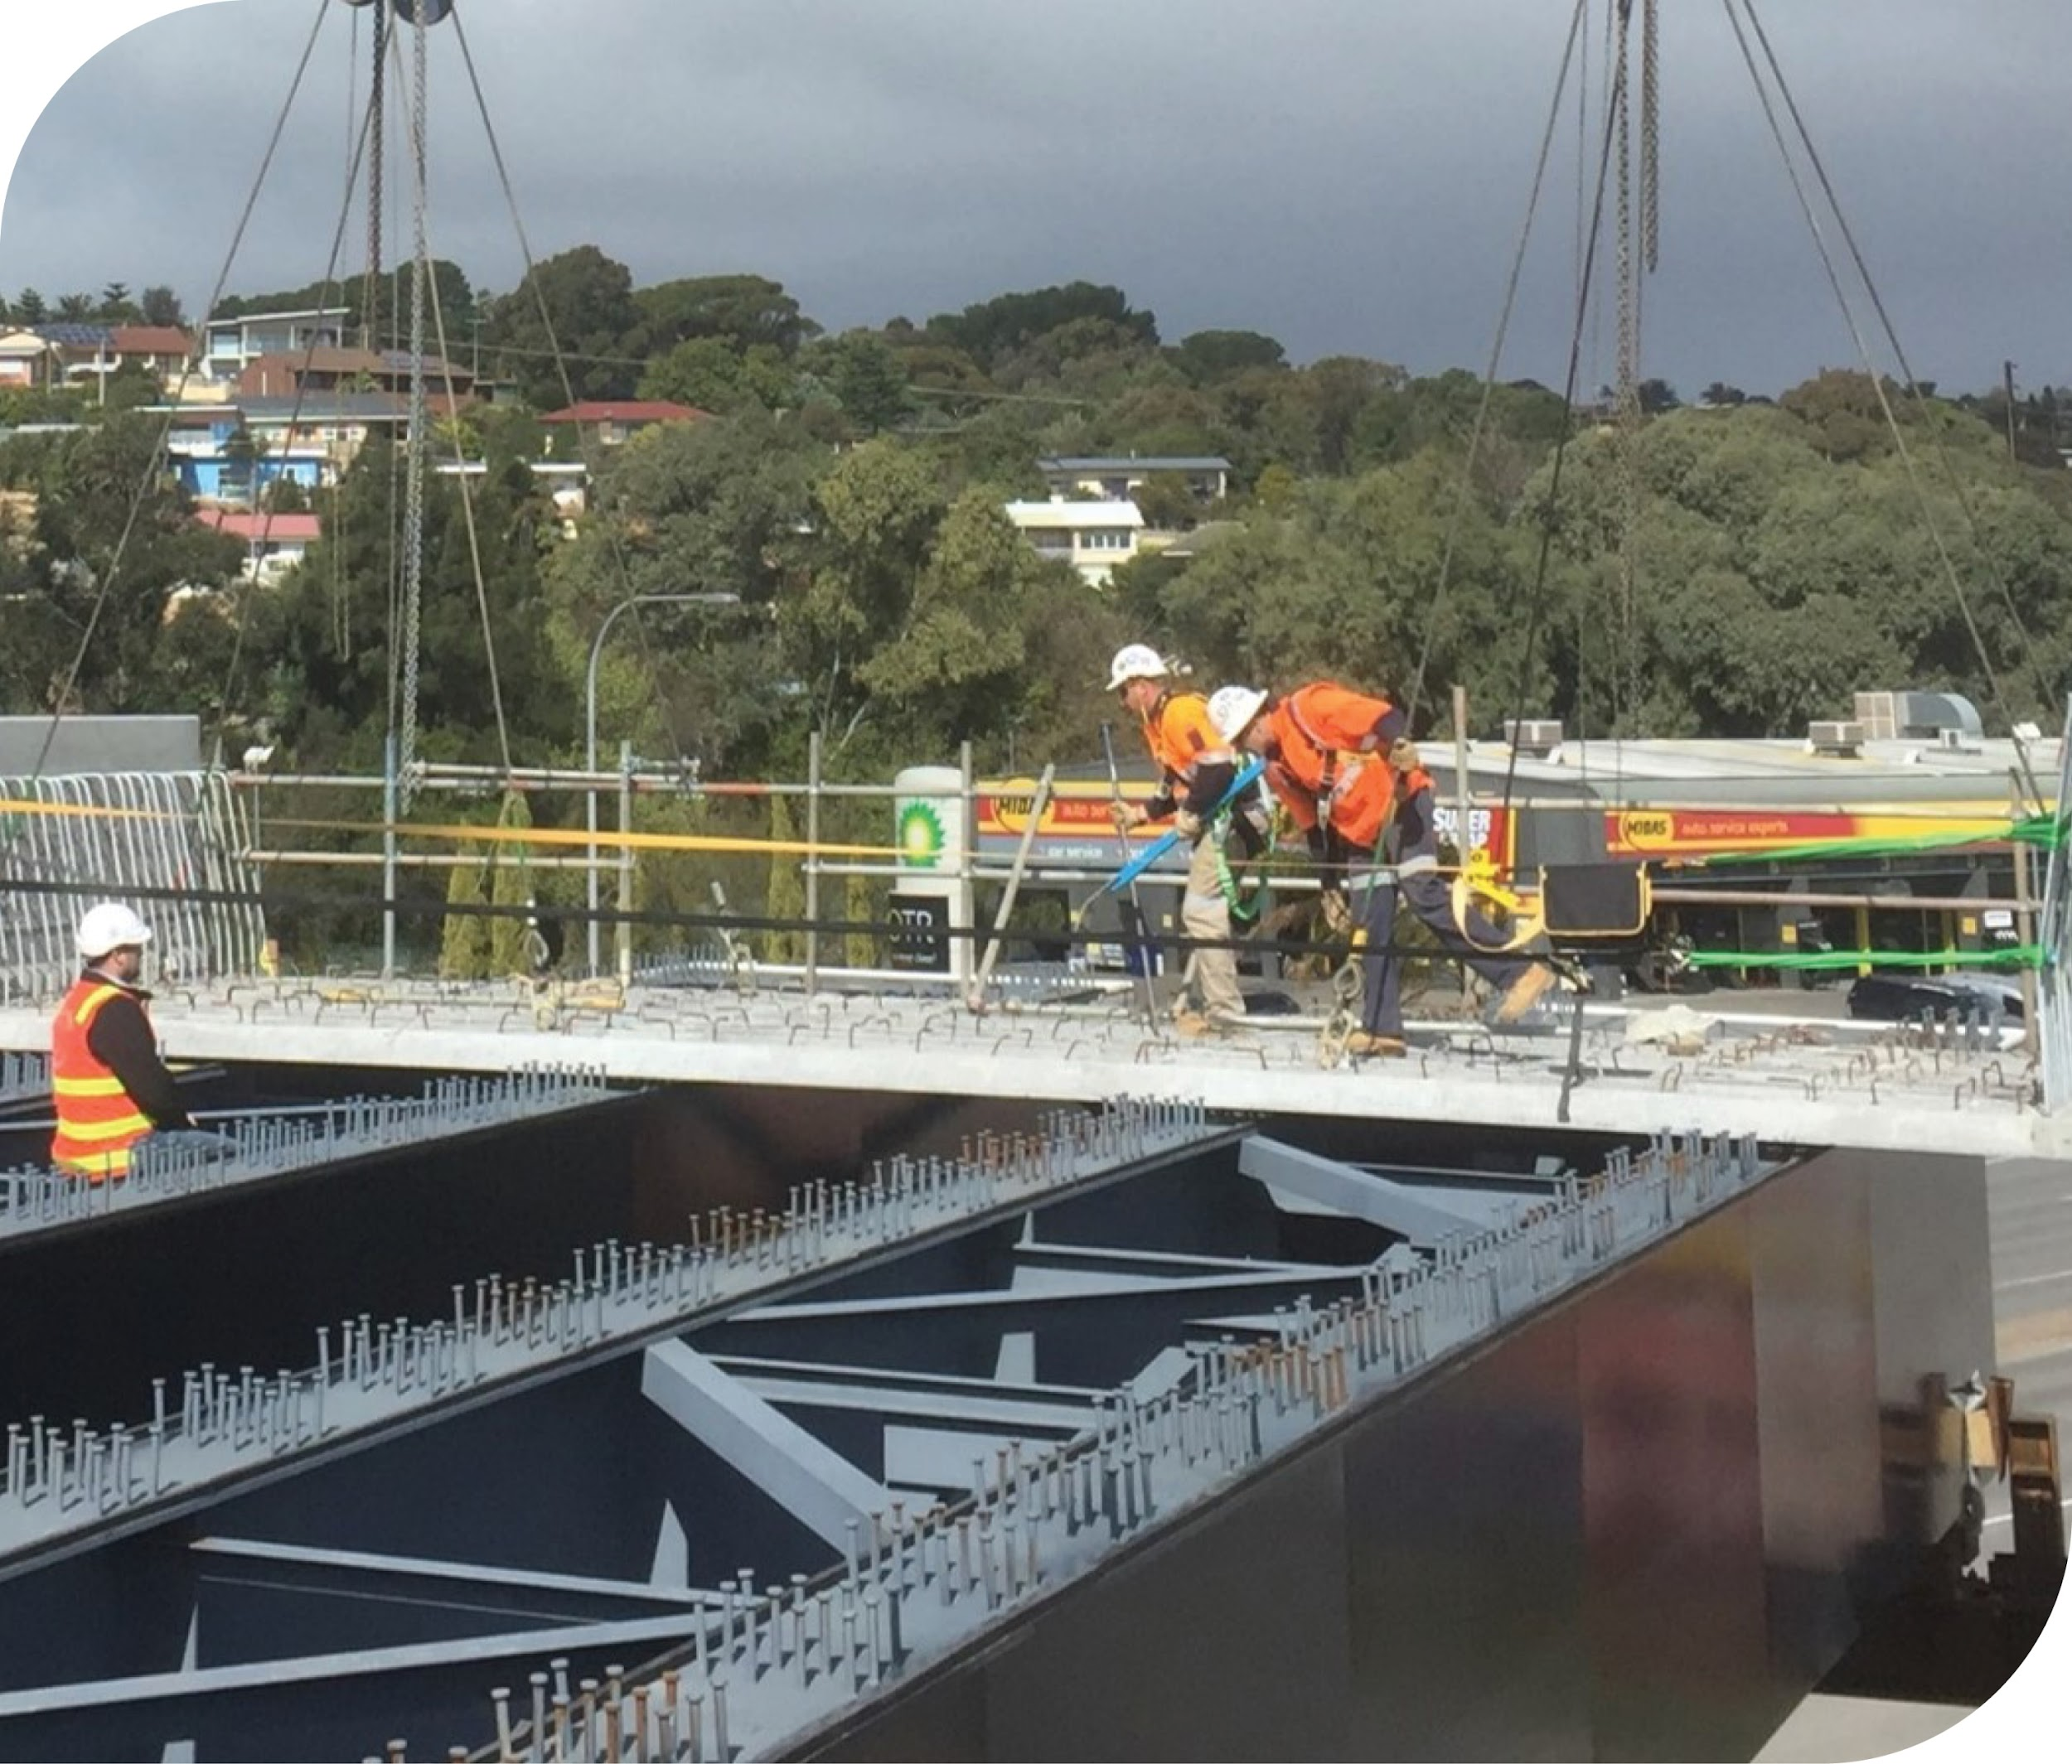
Over quite a few of our projects, we have been lucky enough to experience this ECI approach and the benefits that it can provide.
This Bridge structure example will help demonstrate a critical inter-dependent trade overlap. Specifically, there was a heavily reinforced precast concrete deck as you can see in the picture (supplied by the Precast Subcontractor)
Notes:
· The process involves the precast segments being placed over shop welded shear studs. The studs are fixed to the steel girders that support the precast (Girders and studs are supplied by Steelwork Fabricator).
· These hybrid materials really use their individual strengths to perform well in a structural context, but only if they “talk to each other”.
· Connectors on the steel girders from the steelwork fabricator need to line up almost perfectly with the precast pockets on the panels supplied by the precaster.

Slide 5
The process involves the precast segments being placed over shop welded shear studs. The studs are fixed to the steel girders that support the precast (Girders and studs are supplied by Steelwork Fabricator).
These hybrid materials really use their individual strengths to perform well in a structural context, but only if they “talk to each other”.
Connectors on the steel girders from the steelwork fabricator need to line up almost perfectly with the precast pockets on the panels supplied by the precaster.
Notes:
· The process involves the precast segments being placed over shop welded shear studs. The studs are fixed to the steel girders that support the precast (Girders and studs are supplied by Steelwork Fabricator).
· These hybrid materials really use their individual strengths to perform well in a structural context, but only if they “talk to each other”.
· Connectors on the steel girders from the steelwork fabricator need to line up almost perfectly with the precast pockets on the panels supplied by the precaster.

Slide 6
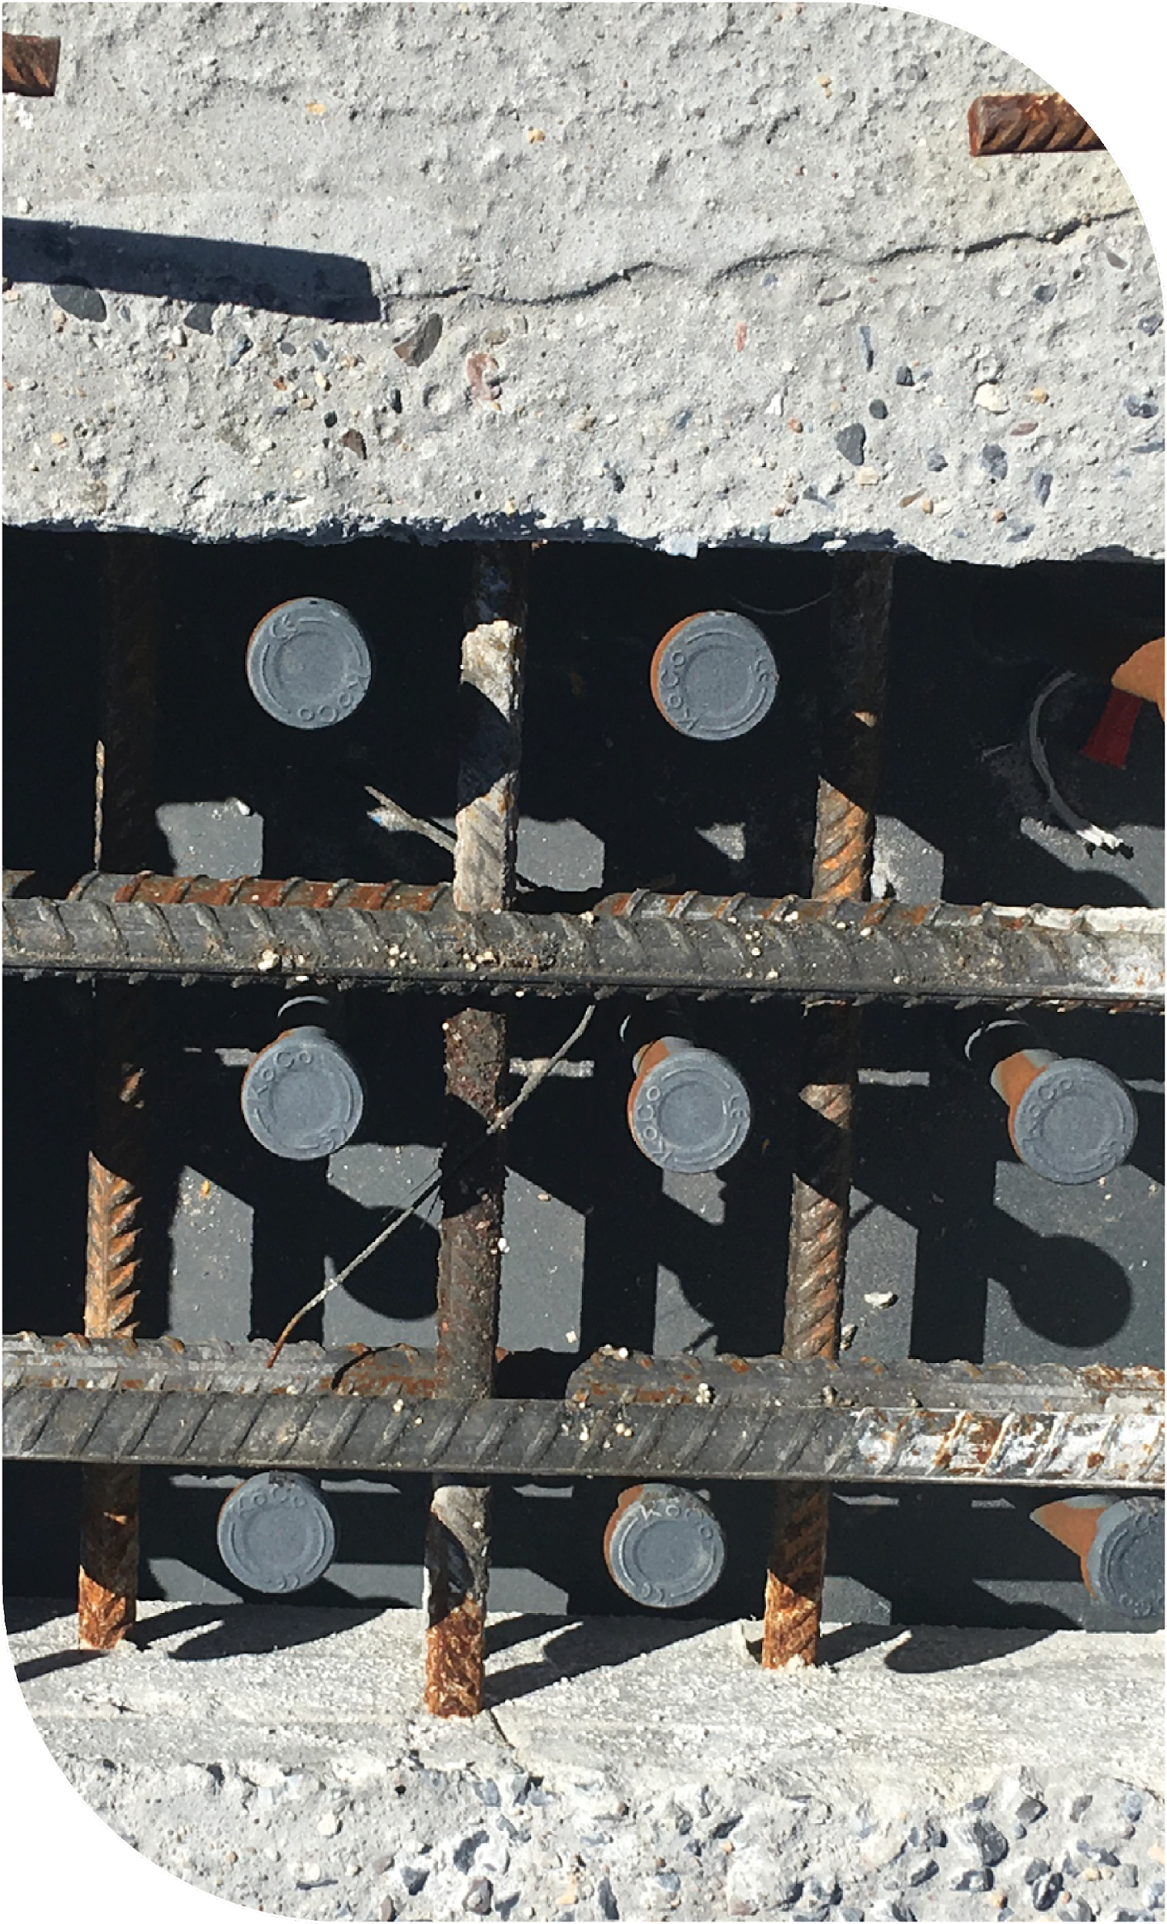
There’s very little tolerance on this fit up and this was identified early because the contractor had engaged the critical trades before design was finalised, they allowed the right forum to discuss the technical details.
They flagged their concern to the right people from the critical trades. The result allowed an exchange of different ideas in a room with an electronic model for visualisation, all parties were able to look closely at how this potential issue could be de-risked in the most efficient and effective way.
Notes:
· The process involves the precast segments being placed over shop welded shear studs. The studs are fixed to the steel girders that support the precast (Girders and studs are supplied by Steelwork Fabricator).
· These hybrid materials really use their individual strengths to perform well in a structural context, but only if they “talk to each other”.
· Connectors on the steel girders from the steelwork fabricator need to line up almost perfectly with the precast pockets on the panels supplied by the precaster.

Slide 7
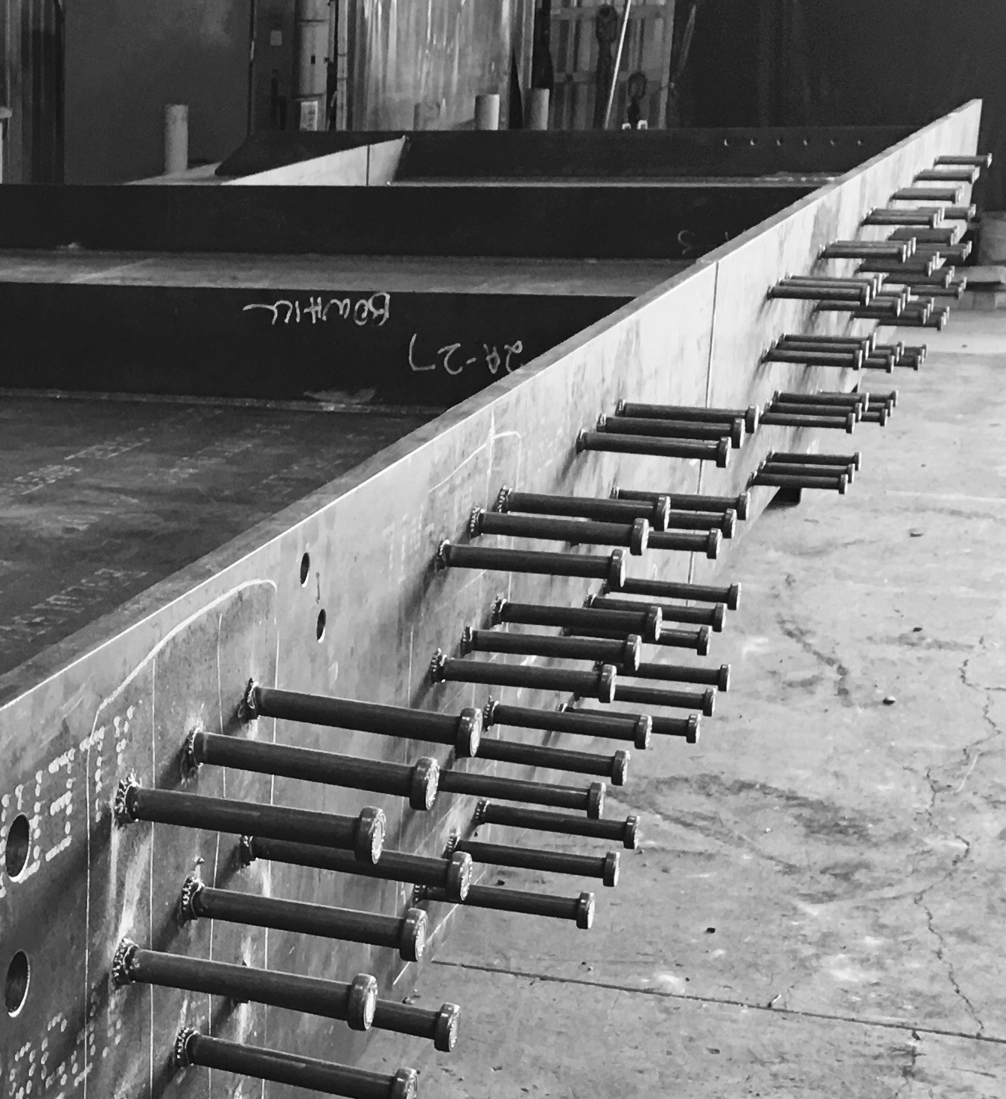
The outcome of this process has seen successful workshop firing of around 50,000 shear studs, without one requiring removal on site to allow the precast section to fit in place.
This was only possible because the two subcontractors had a meaningful chance to coordinate their methodologies and make the whole process work successfully.
Notes:
· The outcome of this process has seen successful workshop firing of around 50,000 shear studs, without one requiring removal on site to allow the precast section to fit in place. This was only possible because the two subcontractors had a meaningful chance to coordinate their methodologies and make the whole process work successfully.

Slide 8
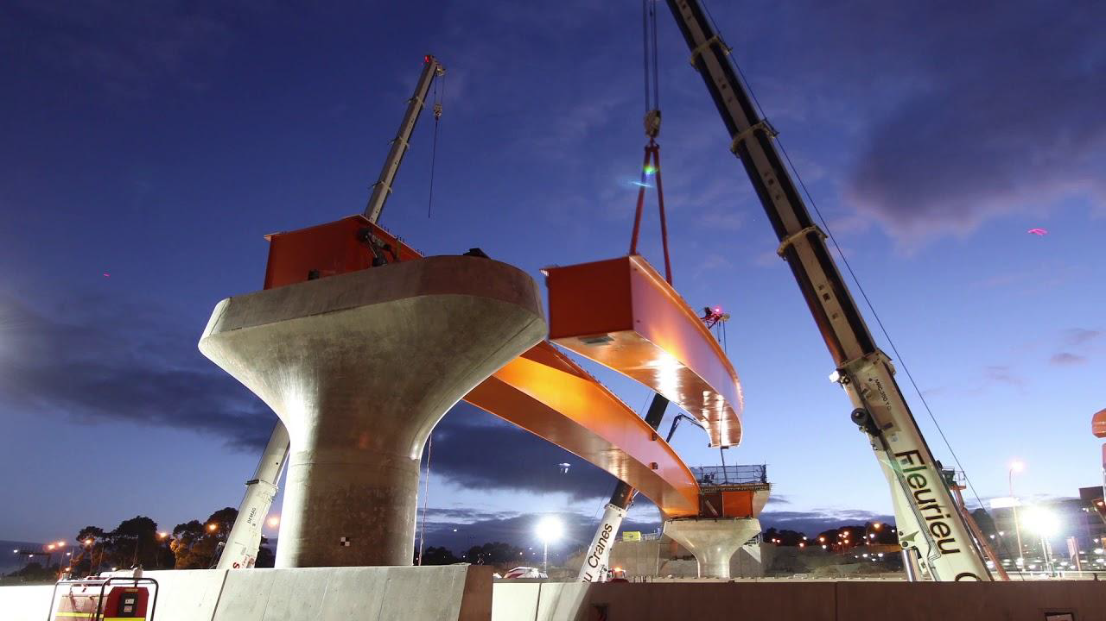
Without this coordination there could have been all kinds of issues on site!
The finger would get pointed at everyone and then the contractual process of administering blame and cost would have taken place.
The motivation to get not just your own work right but the whole process coordinated is worth the early efforts.
Notes:
· Without this coordination there could have been all kinds of issues on site, if the precast panels didn’t fit over the shear studs the construction program is effected, the erection/crane company is back charging someone, the studs would need to be cut off and welded on site above a road or rail line requiring either traffic management or rail shutdown (both big deals) and the list of challenges and cost continues. The finger would get pointed at everyone as to whose issue it was, and then the contractual process of administering blame and cost would have taken place. So, the stakes are high and the motivation to get not just your own work right but the whole process coordinated is worth the early efforts.

Slide 9
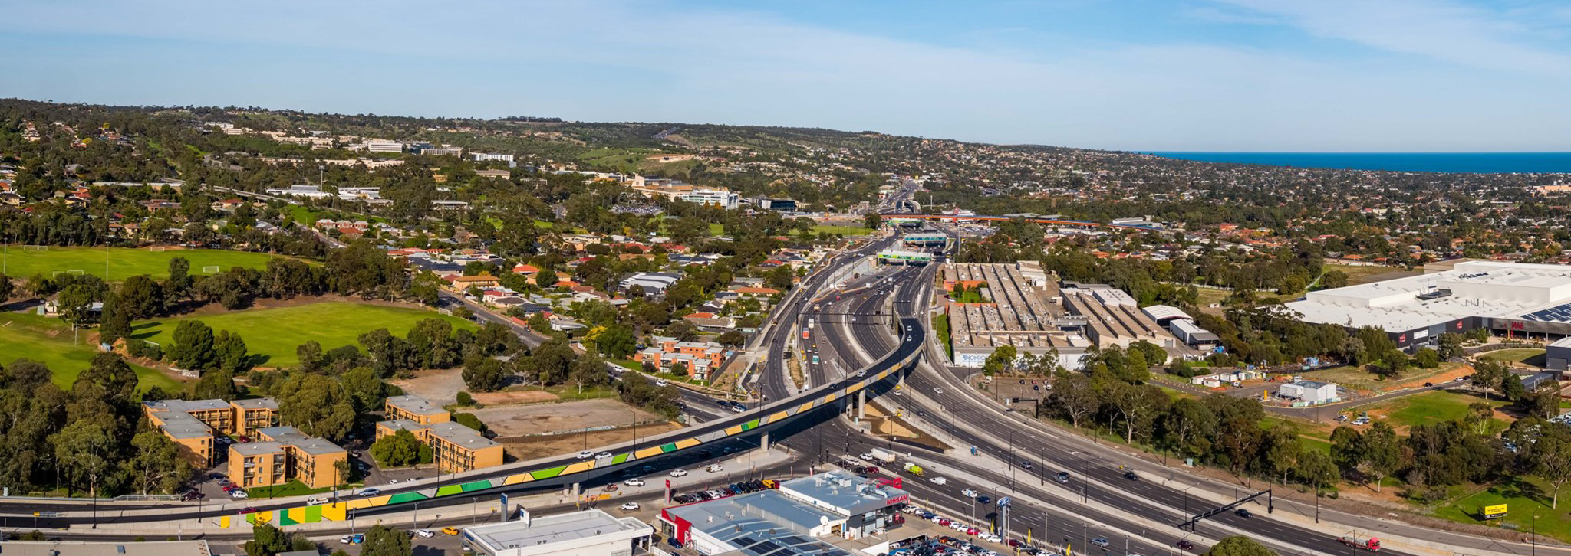
This simple approach and resulting example took risk out of the whole project for the subcontractors, the contractor and the client, we were all happy with the outcome and the project was successful in the eyes of all involved as well as onlookers such as the public and others within the industry.
Notes:
· This simple approach and resulting example took risk out of the whole project for the subcontractors, the contractor and the client, we were all happy with the outcome and the project was successful in the eyes of all involved as well as onlookers such as the public and others within the industry.

Slide 10
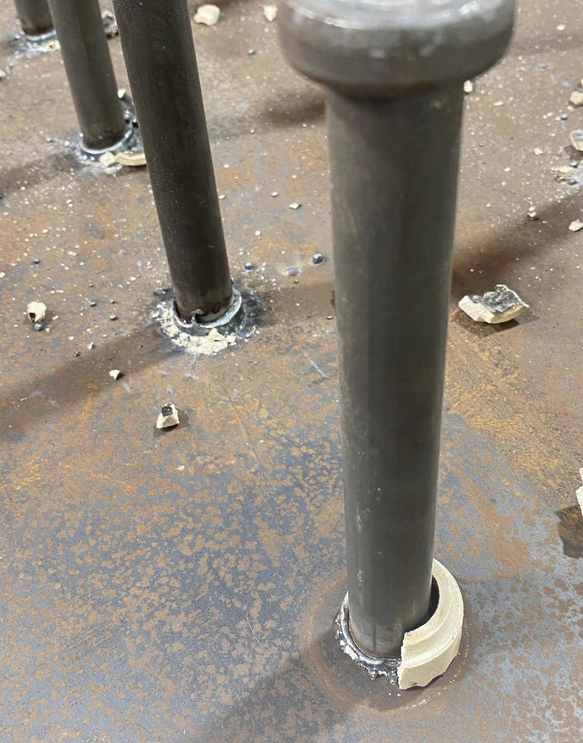
How did we Derisk the process?
Modelling in the exact locations on the structure and providing this 3D model directly to the precast concrete subcontractor so that they can effectively coordinate where their reinforcement goes.
Etch marking the location onto the steel plates whilst on the CNC processing equipment takes out any opportunity for human misinterpretation and provides an effective and low cost way to error proof the process.
Very contrasting outcomes, I’m sure we have seen both scenarios play out in our experience.
I know which one I would rather be a part of!
Notes:
· This simple approach and resulting example took risk out of the whole project for the subcontractors, the contractor and the client, we were all happy with the outcome and the project was successful in the eyes of all involved as well as onlookers such as the public and others within the industry.

Slide 11
There are many positive outcomes from ECI
Next-level understanding
Sharing of knowledge
Building relationships
Learning together
Wining, but not at someone else’s expense!
Winning together! Together we Thrive
Notes:
· How is Bowhill Eng achieving growth in a challenging market, how are we doing this in a regional location? How are we able to attract great young talent?
· I believe that talent is attracted to organisations that can provide them with opportunities, often the building of knowledge, linkage to networks, and financial security are high on their requirements.
· ECI can unlock the next-level understanding of critical trade nuances which is normally out of reach because trades normally keep their secrets as their own IP.
· Sharing of knowledge helps to drive down risk, drive up smart, thoughtful and efficient design and encompass the overlapping and inter-dependent trades.
· Building relationships with the best subbies in the industry is a smart approach, it helps your organisation and within the construction industry it limits your competitors access to them.
· Learning together and creating an inter-dependent culture where “none of us are as smart as all of us” make a strong team approach. Very hard to keep success away from a strong team!

Slide 12
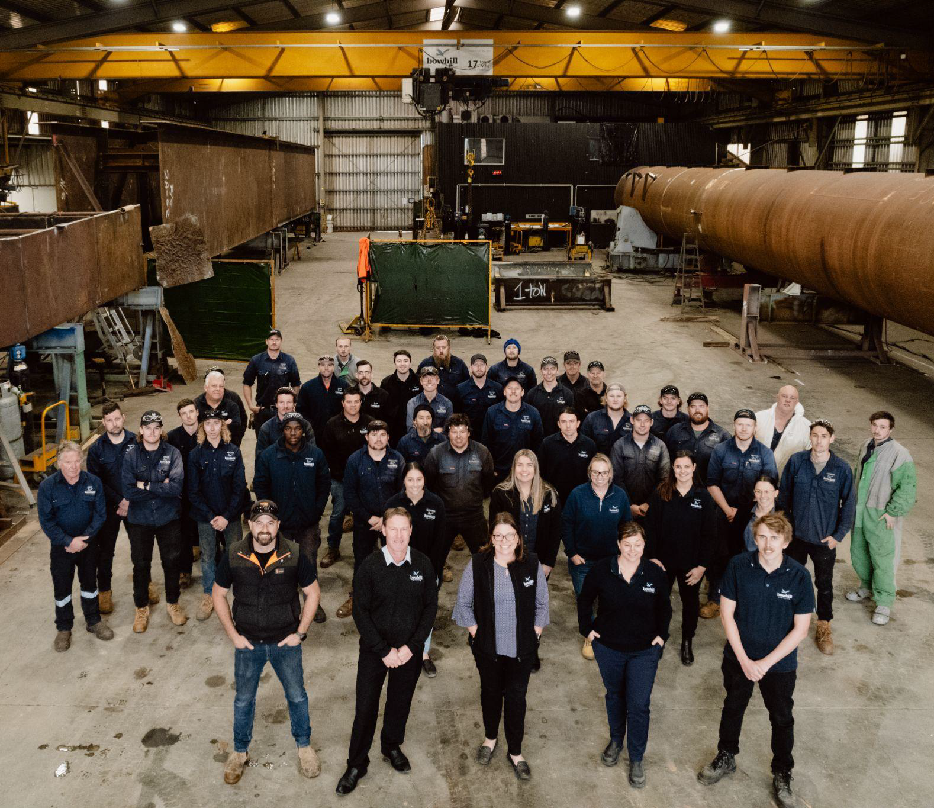
Our Mission
We transform communities & our people by optimising & building structures that matter.
Notes:
· Magic can happen, industry norms can be surpassed with better more unified design that supports the whole supply chain and program.
o With the right people (experienced in diverse but complimentary ways),
o Working together to an aligned goal, where all parties can benefit from smarter solutions
o Freedom for brainstorming and challenging the status quo and inter-dependent exchange of ideas
· At Boweng, we live our values everyday, they are critical in supporting our strategy, our clients value what we bring to their projects and the benefits that we can help to unlock.
· I wonder if the approach that Bowhill takes towards their projects has any value in a fast growing defence industry?
· We hope so because our mission is to Transform communities and our people by optimising and building structure that matter.

