Slide 1
Technology use case

Slide 2
Prominent hill headframe

Slide 3
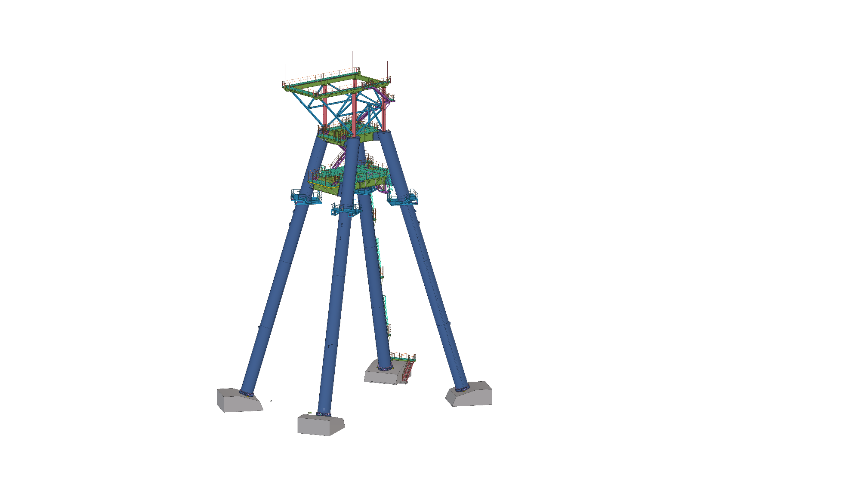
67m Tall
53m Legs
4 parts – 30T each
2.4m Diameter pipe
1.6km Cable length
2x 30T ore buckets
60kmph
400T UPPER ASSEMBLY

Slide 6
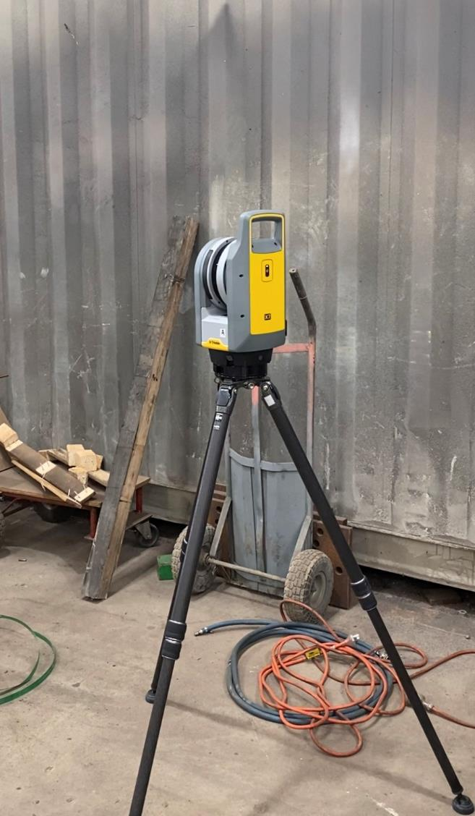
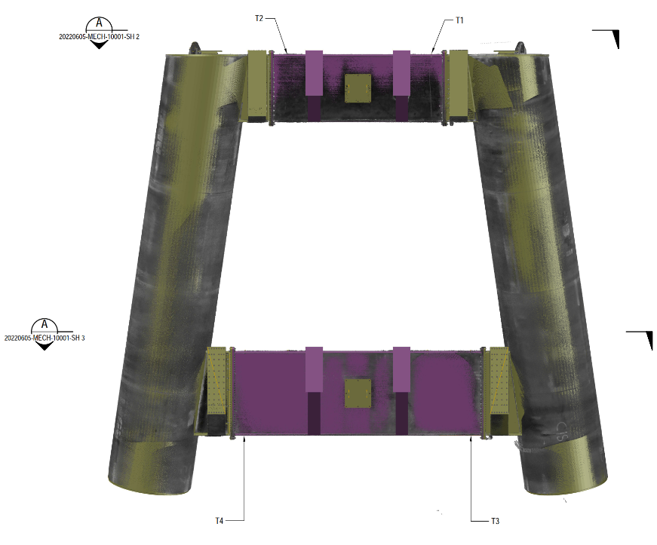

Slide 8
Key learnings
Heat distortion
Digital data collection
Because of the large plate size for box beams / Can connections, heat distortion couldn’t be controlled.
Machining was needed to return distortion into a flat face.
Machinists needed clear and accurate data to complete contract.
In-Situ machining has not been done at Bowhill Engineering before.
Due to the large quantity of connections, traditional measurement was not satisfactory.
Point cloud data was not applicable for data interrogation.
New technology was implemented from various recommendations.
Point cloud data
Total station measurement
Flatness survey

Slide 10
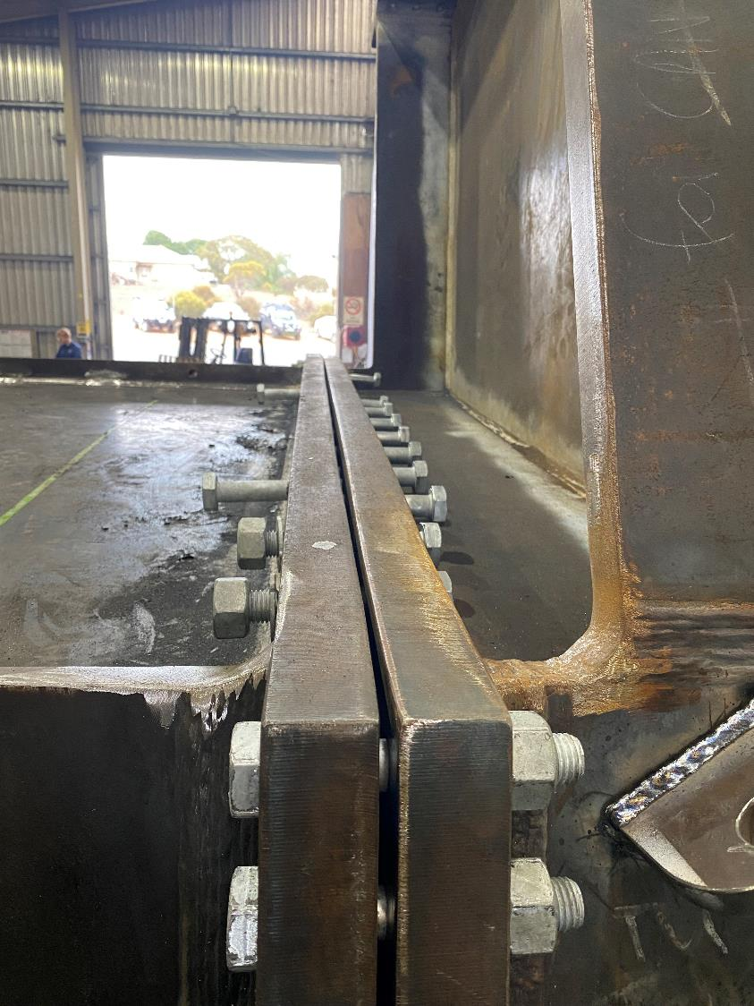
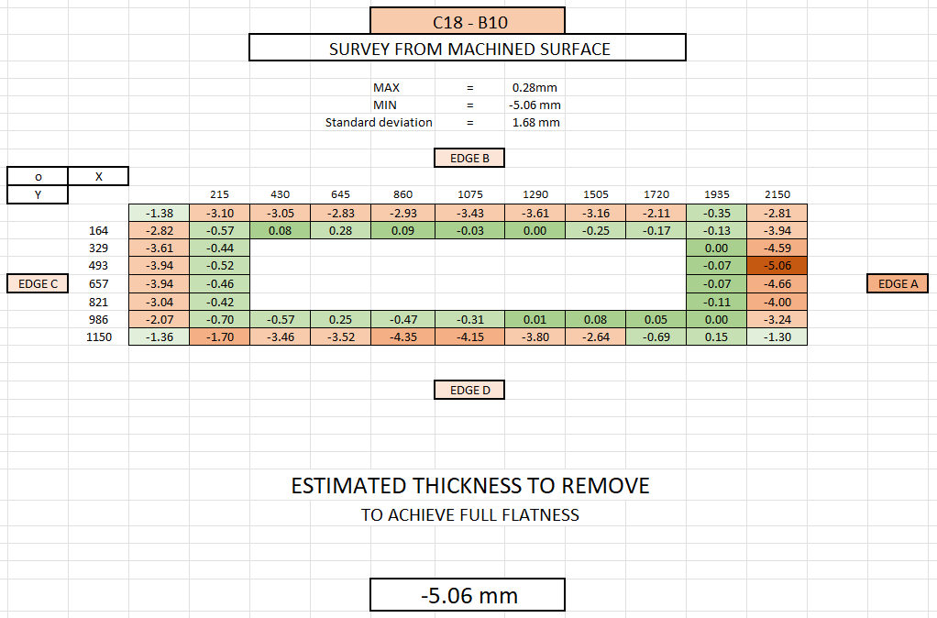

Slide 11
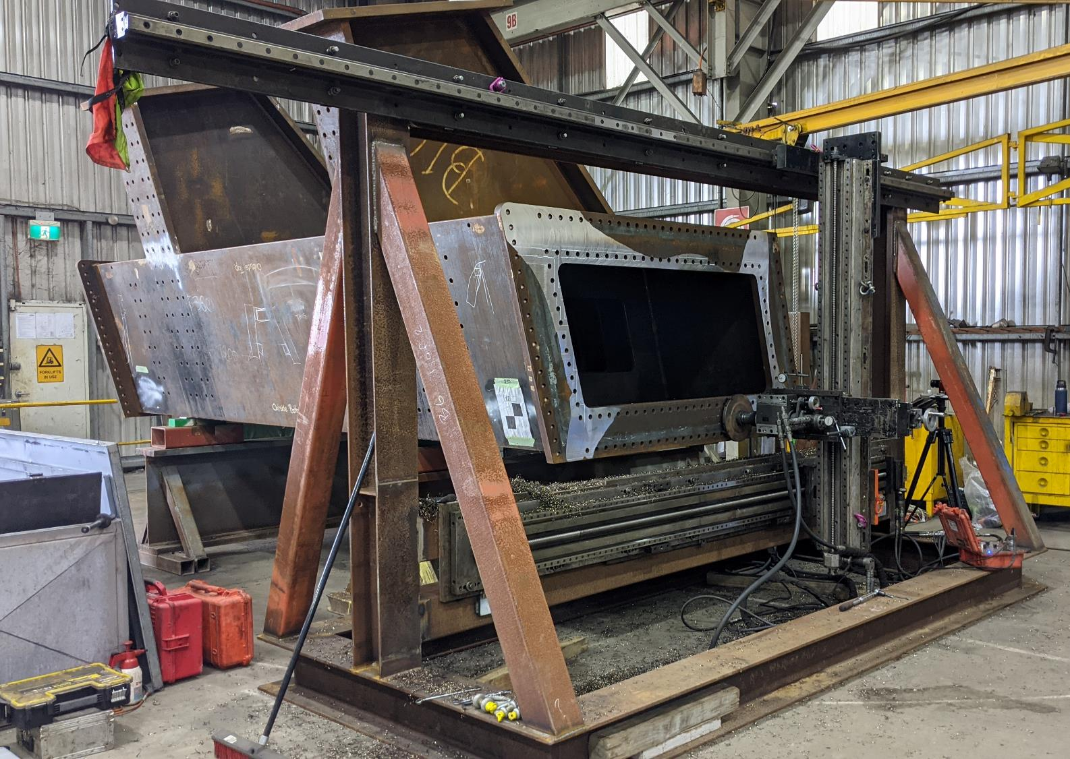

Slide 13
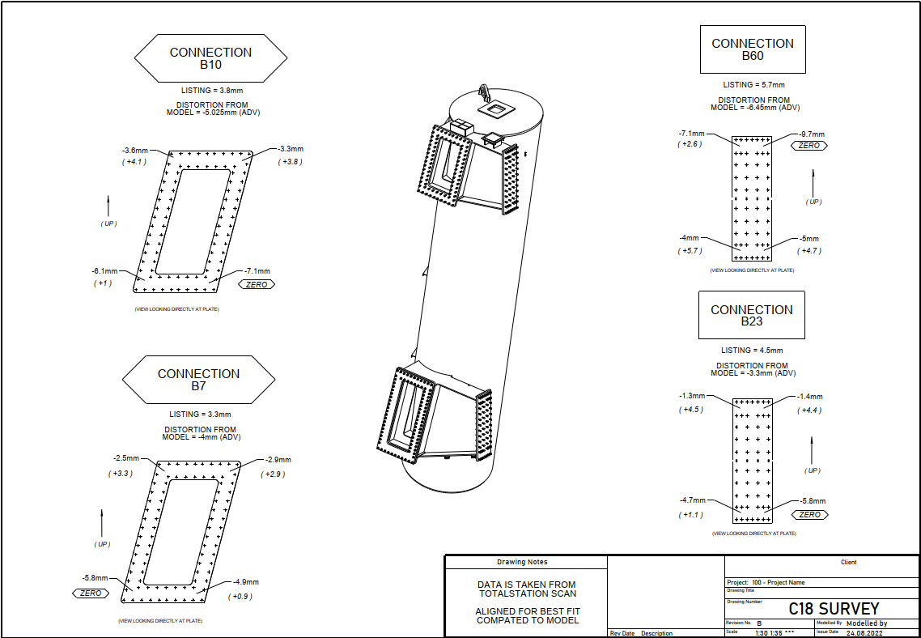

Slide 14
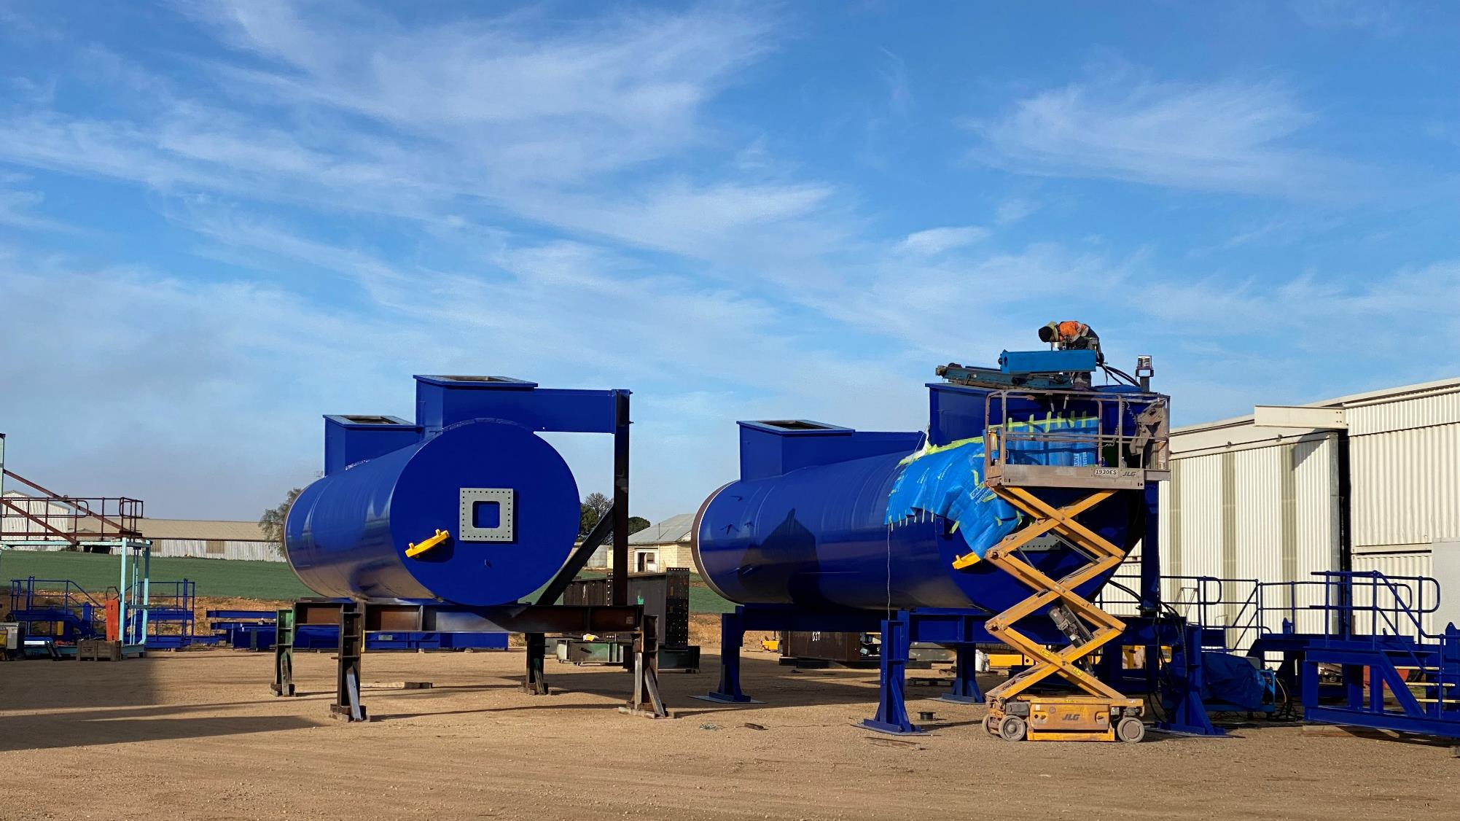

Slide 15
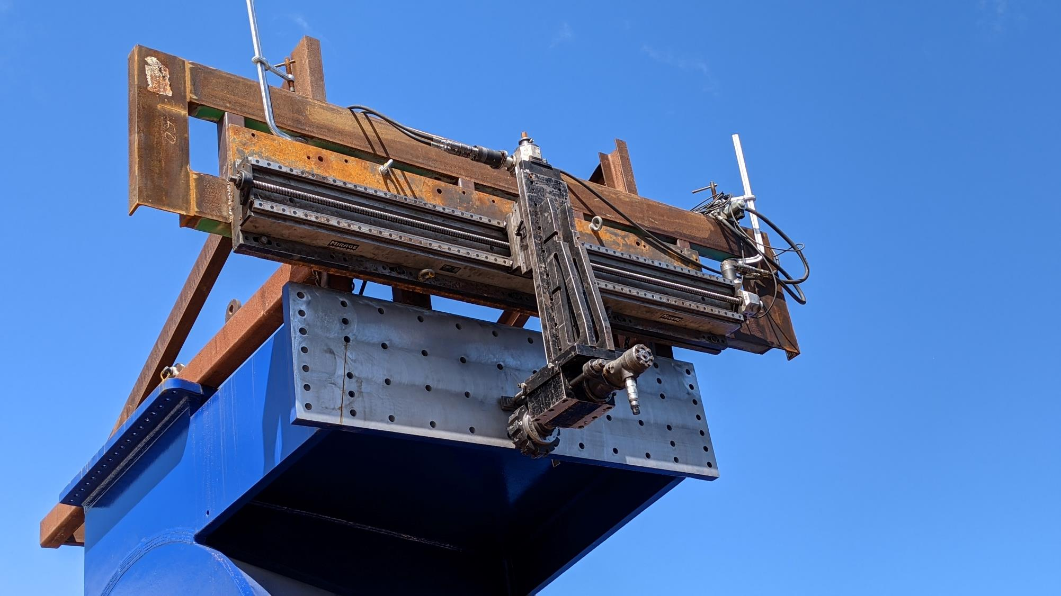

Slide 16
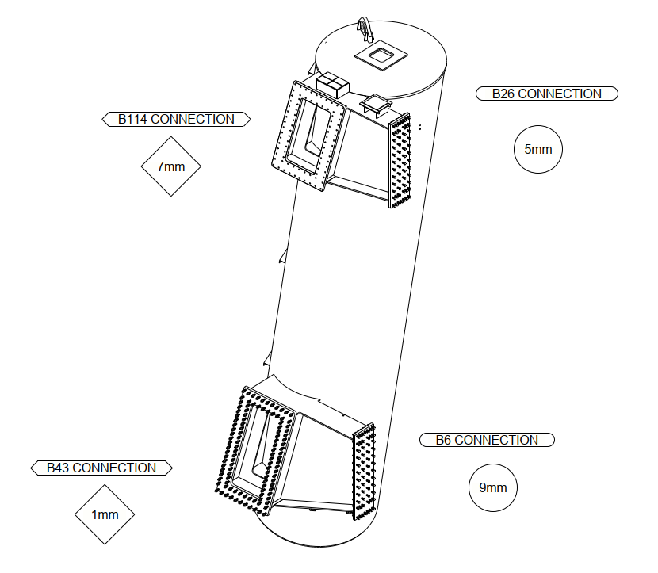

Slide 17
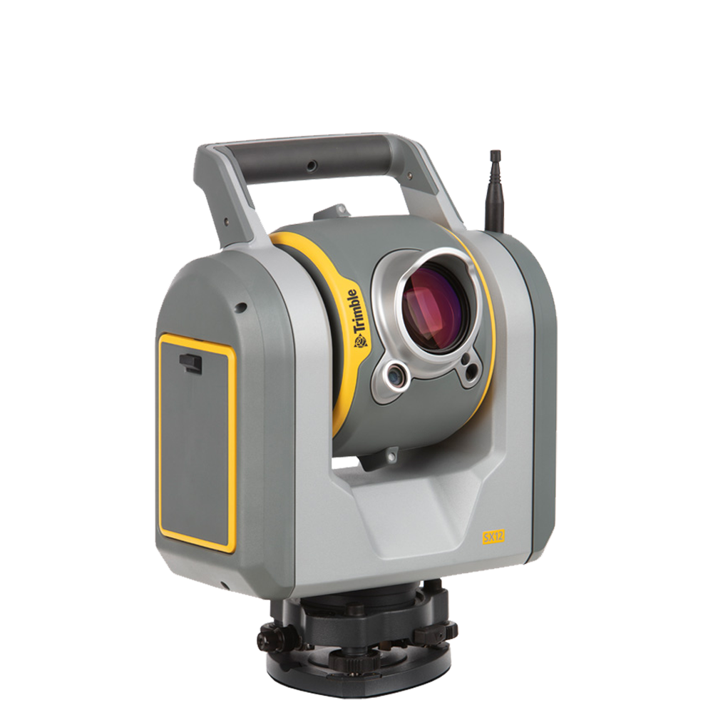
SX-12
Robotic totalstation
The SX12 is a robotic total station with scanning capabilities, meaning we can use it to achieve high accuracy measurements as a total station, but also use it as a point cloud if a site inspection was required for a project. This model gives additional functionality to the surveyor,

Slide 18
TOTAL-STATION SURVEY

Slide 20
Point cloud scan

Slide 21
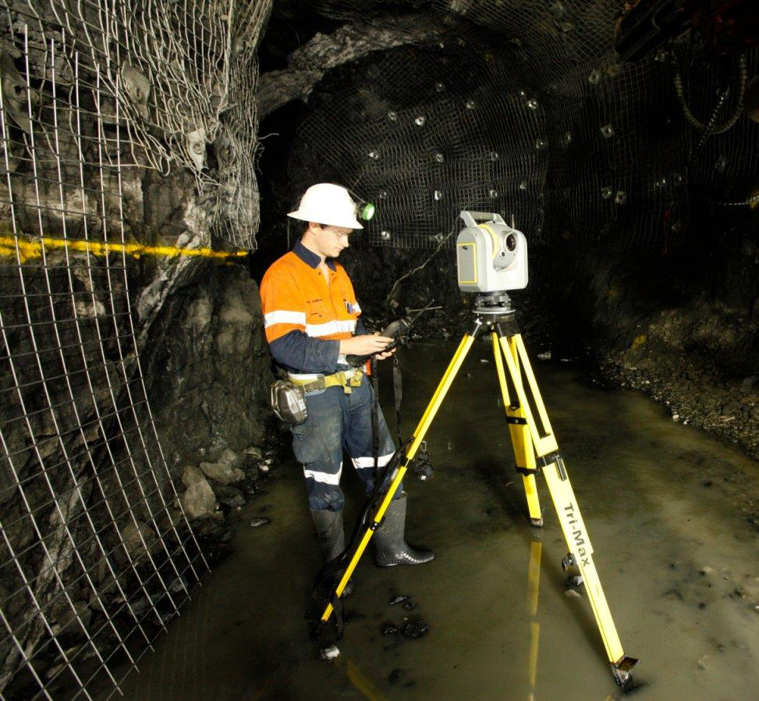
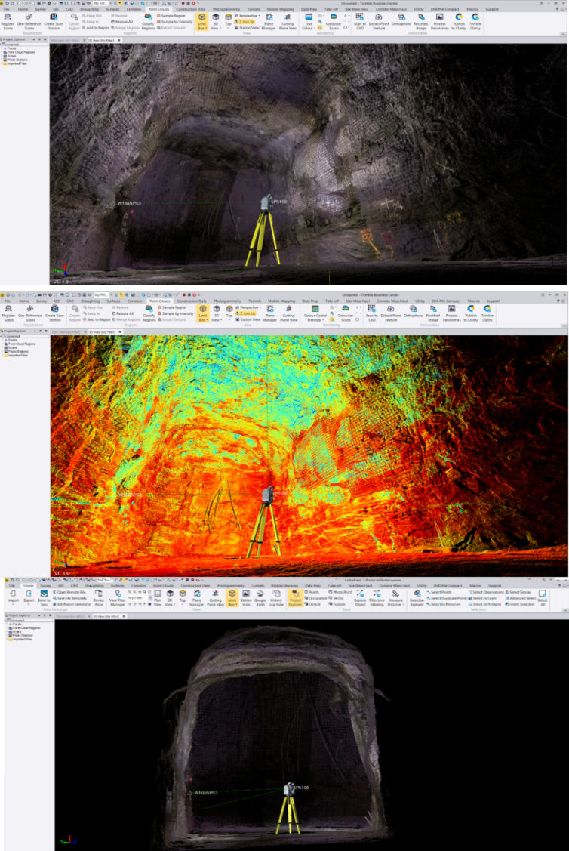

Slide 22
Sx-12 features
Autonomous design
Total - station survey
Point cloud scan
Post - scan measurement

Slide 23
SUMMARY
At Boweng…

