Slide 1
Connections & Leveraging Opportunities
Jodie Hawkes

Slide 2
Agenda
Blog – How often are you too busy to read that email?
Connections – Industry & Business Groups
Opportunities
Latest
Largest
First
Current Opportunities
Cyber Awareness – DISP
ESG – Maximum Energy

Slide 3
Leveraging Opportunities How often are you too busy to read that email?
So many of us are time poor, but are we really?
Finding the GOLD in an industry newsletter or podcast just may save you time & money tenfold. Hear how I have leveraged multiple opportunities, just because I took the time to read.
Continue Reading...

Slide 4
Connections
It’s important to surround yourself with the latest information, Bowhill Engineering is proud to be associated with:

Slide 5
Opportunities
Latest - 2022
Largest - 2020
First - 2014
Next
AusIndustry – Growth Roadmap
$20k – 50/50
Wellness Program, HR Onboarding Software
Energising Bowhill Project
$1m – 50/50
Unlocking Growth, undergrounding power & 100kw solar
EC - Continuous Improvement Program
Business & Operational Excellence
Cyber Security – DISP
ESG – Maximum Energy

Slide 6
Opportunities
2015
2012
2011
2009
AusIndustry – Business Growth Grant
$30k 50/50
Strategic & Marketing Plan - JWPM
Enterprise Connect – TAS Grant
$10k 50/50
Sharepoint Intranet for QSE
Enterprise Connect – TAS Grant
$6k 50/50
QSE Gap Analysis
Enterprise Connect – TAS Grant
$4k 50/50
Joint Venture Agreement

Slide 7
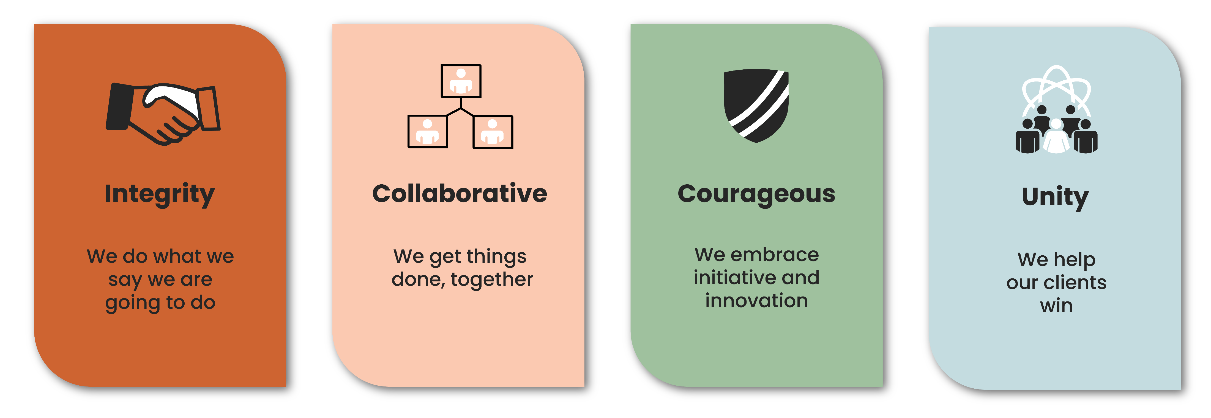
We have INTEGRITY because we do what we say we are going to do. We are COLLABORATIVE because we use the experts to our advantage. We are COURAGEOUS because we are open to new opportunities and a smarter way to work. We have UNITY as we not only help our clients win, but ensure that our community does too.

Slide 8
Cyber Security
Australian Cyber Security Centre
Have you been hacked?

Slide 9
Cyber Aware - DISP
2020
Defence.gov.au/security/industry
Working Securely with Defence Guide
2020
Cyber Assessment Report
Part 1 – Assessment
Part 2 – Action Plan
2021
Personal Security Clearance
2022
2022
DISP Policies & Procedures Update to 2022 version
80% To be submitted Nov
DBRT
Defence Business Readiness Tool Submitted June
Baseline/Entry Level
Submitted Oct

Slide 10
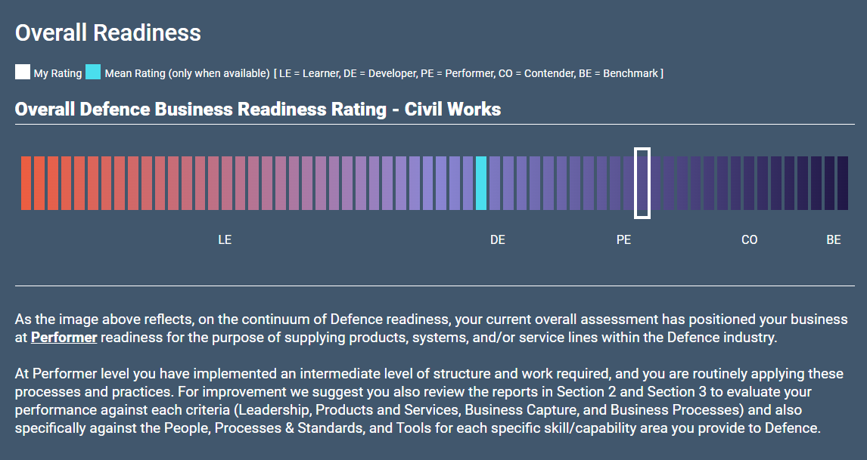
Cyber Security - DBRT

Slide 11
Cyber Security – Microsoft Score

Slide 12
Cyber Security – Essential 8

Slide 13
Agenda…
Esg
REGIONAL dEVELOPMENT
LOCAL JOBS PROGRAM
Jed Durdin Maximum Energy
Ben Fee Chief Executive
Julie Bates Director of Business Development
Christine Willersdorf Employment Facilitator

Slide 14
Agenda
NEW TECHNOLOGIES
Murraylands manufacturing alliance
Ethan Klemm Design & Innovation
Brett Kennewell Director Kennewell Engineering
Daniel Kluske Project Manager Moore Engineering

Slide 15
Agenda
PANEL MEMBERS
Dougal Guthrie – McConnell Dowell – Alliance General Manager
Nigel Hird – McConnell Dowell – Area Manager
Adam Yates – Bardavcol Pty Ltd – Construction Manager

Slide 17
Thank You
Bowhill Engineering
admin@boweng.com.au
www.boweng.com.au

