Slide 1
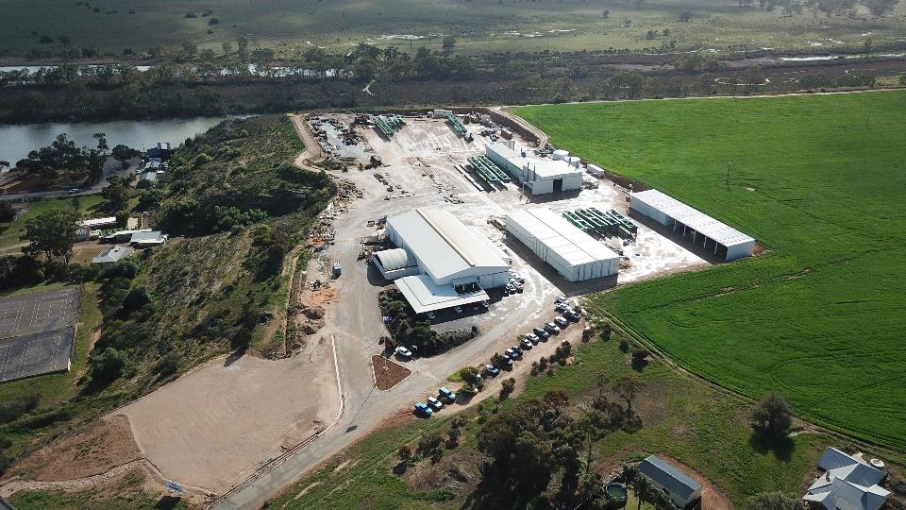

Slide 2
We transform communities and our people, by optimising and building structures that matter together.
What we do
We’re specialist fabricators of heavy and complex structural steel. We collaboratively build structures, from design optimisation through to installation, that benefit many Australians.

Slide 3
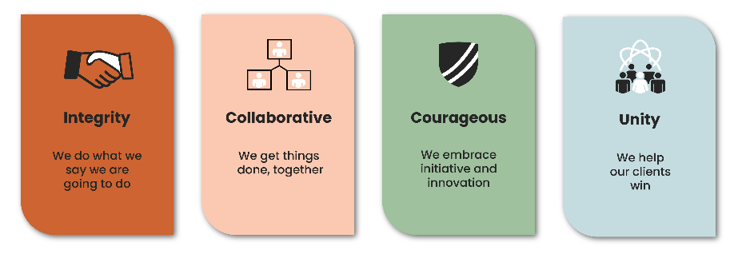
Core Values
Notes:
Bowhill Engineering has enjoyed significant growth over the last 5 years and is highly regarded by its customers and stakeholders as a South Australian success story. The company is seen as having a unique position in the market, specialising in large and complex steel structures.
Bowhill Engineering's recent growth has been driven through nurturing collaborative relationships with major construction partners and delivering solid performance on large-scale infrastructure projects (primarily road projects with bridge components).
Customers value the relationship that they have with the Bowhill team, the honesty and transparency, the expertise and (proactive) initiative provided, ensuring cost effective and constructable solutions.
JWPM Consulting – Summary of their External Scan

Slide 4
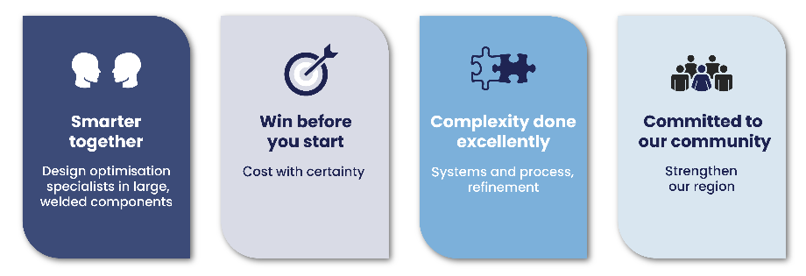
Core Competencies
In an increasingly competitive and high-stakes infrastructure game, you need a bidding edge. And the bidding edge comes from working with a specialist heavy and complex steel fabrication supplier who will partner with you — not just take your order.
Notes:
Smarter Together
We start by bringing together a team of experts across design, surveying, drafting, engineering, fabrication and surface treatment, transportation & logistics, and erection to ask the questions others don’t and find
the efficiencies others can’t.
Win before you start
When you’re looking for specialist heavy and complex steel engineering, most fabricators talk quality; we’ve got 40 years demonstrating it. Our facilities
and equipment are set up to handle the heavy, large and complex parts of any project — think ferry hulls and 50m long road bridge girders.
Complexity done excellently
We’re able to offer certainty of costs because we control our end-to-end process by designing, fabricating, preparing, and painting all our steel under one roof. By being able to take care of the transport through to on-site
erection, we’re able to control what happens to the whole process.
Committed to our community
Helping the community isn’t something many structural steel engineers boast about, but as a multigeneration family-owned business, contributing to our community is part of our DNA — and it’s what sets us apart.

Slide 5
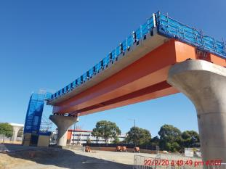
Good to Great
Our ECI program will help you win before you start!
Bowhill Engineering have developed years of experience with regards to ECI (Early Contractor Involvement),
We establish mutually beneficial sustainable partnerships with a trust base and collaborative relationship.

Slide 6
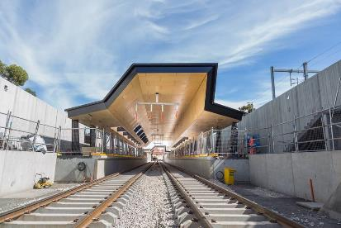
Good to Great
Financially solid, high performing and innovative
2nd generation regional family business
40+ years in business
Diverse workforce with a training focus
12 apprentices and 5 trainees
We invest in our people's future (2%)
Our NPS is currently 100 as rated by our clients.

Slide 7
Well Positioned for Growth
Operational Excellence
Our People, Our Culture
Business framework of policies and procedures are well advanced in readiness of growth and scale.
We are agile, fluid and nimble
Governance
Clarity – purpose, direction and strategy

Slide 8
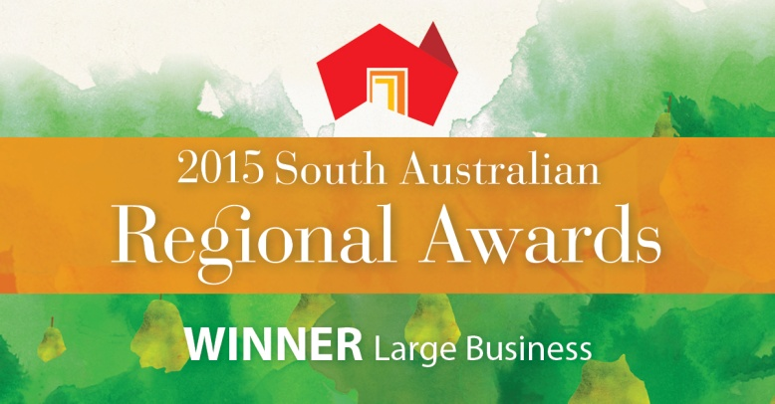
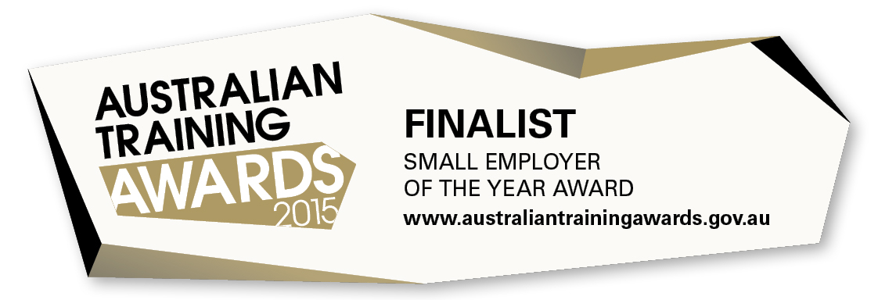
Success

